Slide 1
Types of Operating Systems
Lecture 2

Slide 2
Functions of Operating system
User Interface
Process Management
Resource allocation
Disk management/ file management
Memory management

Slide 3
Mainframe Systems
Batch systems
Time-sharing systems

Slide 4
Batch Systems
Machines run from the console
Input devices: Card readers /Tape drives
Output devices: Line printers, Card punches
User did not interact directly with computer system
Professional operators do the work
A job is prepared by the user which the user give to the operator to submit that in the system.
The result of the job is given back to the user.

Slide 5
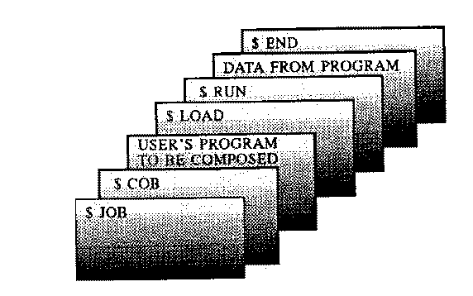
Batch Systems
Job: Program, the data, and some control information about the nature of the job.

Slide 6
Example
$COB-Execute the COBOL compiler
$JOB-First card of a job
$END-Last card of a job
$LOAD-Load program into memory
$RUN-Execute the user program

Slide 7
Batch Systems
The sequencing of operations involved in program execution: Jobs with similar requirements were batched together and run through the computer as a group.
For example: Suppose the operator received one FORTRAN program, one COBOL program and another FORTRAN program. If he runs them in that order, he would have to set up for FORTRAN program environment (loading the FORTRAN compiler tapes) then set up COBOL program and finally FORTRAN program again. If he runs the two FORTRAN programs as a batch, however he could set up only once for FORTRAN thus saving operator's time.

Slide 8
Multiprogrammed Operating System
Multiprogramming increases the CPU utilization by organizing the jobs so that CPU always has one to execute
Operating systems keeps multiple jobs/programs in the memory simultaneously
The operating system picks one of the jobs and begins to execute.
The CPU never sits idle in this case.

Slide 9
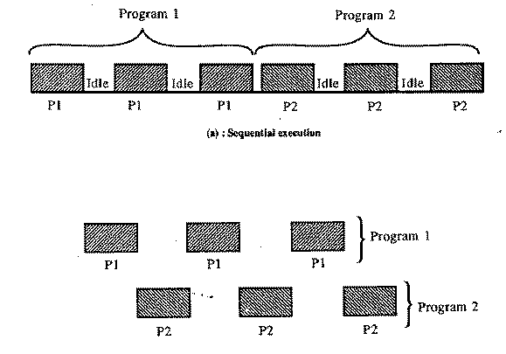
Multiprogramming OS
More number of programs competing for system resources, better will be resource utilization..

Slide 10
Time Sharing Systems
Time Sharing Supports interactive users. It is also called multitasking
Multitasking Operating systems
A multitasking OS allows you to run multiple processes (tasks) "simultaneously". They do not actually run at the same time, of course, since there is only one CPU. What happens is that one process runs for a while, then the OS breaks in (through an interrupt), stores away the state (context) of the current process, restores the context of another, and allows that other process to run for a while.
It can be preemptive or cooperative

Slide 11
Time Sharing Systems
A timeshared OS uses CPU scheduling and multiprogramming to provide each user with a small portion of a time-shared computer
In time sharing each user is given a time-slice for executing his job in round-robin fashion. Job continues until the time-slice ends
Time sharing systems can run several programs at same time so it is called Multiprogramming systems, but multiprogramming operating system is not a time sharing system.

Slide 12
Multiprocessors Operating system
Also called parallel systems or tightly-coupled systems
Such systems have more than one processor close in communication, sharing the computer bus, memory and peripheral devices.
Advantages:
a) Increased throughput
b) Increased reliability

Slide 13
Multiprocessors Operating system
There are two types of Multiprocessor operating system:
Symmetric multiprocessor- All processors share the work.
all CPU’s are treated equally.
Also called as UMA
Asymmetric multiprocessor- Master- slave concept
All CPU’s are not equal
Also called as NUMA

Slide 14
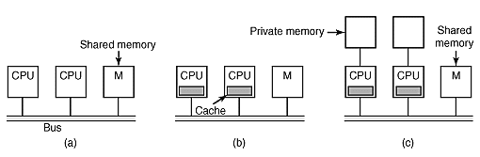
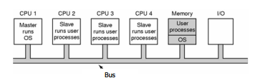
Multiprocessors Operating system

Slide 15
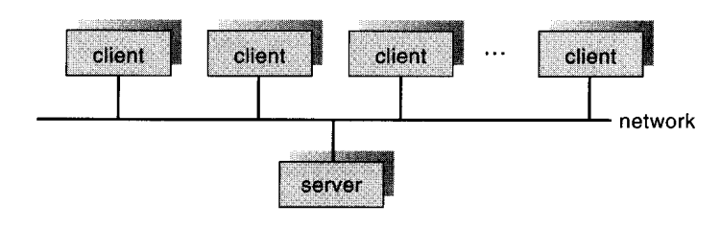
Distributed Systems
Distributed systems depends on the network for their functionality. Also called Loosely coupled systems
Three variations of distributed systems
a) Client/Sever systems
Peer-to-Peer systems
Network Operating systems- file sharing.

Slide 16
Real Time Operating systems(RTOS)
Special-purpose operating system
A real time operating system is used when rigid time requirements have been placed on the operations of the processor, data flow
A real time systems have well defined, fixed time constraints.
Hard Real time systems
Soft Real time systems
Examples:
Hard real-time = Airplane control systems, Microwave ovens,robots.
Soft real-time = Live Video Streaming

